Slide 1
2022 Internet Recharter Guide and Timeline
National Service Team
Serving and Supporting Units
& Technology
With addendum for Foothills District, Atlanta Area Council
Revised September 20, 2022
Notes:
Thank you Sue and good evening, everyone.
The Internet Recharter Guide and Timeline was created by the National Commissioner Service Team to assist units and commissioners with managing their recharter on a timeline to allow them enough time to submit for proper review prior to their charter due date.

Slide 2
2022 Internet Recharter Guide and Timeline
What is a Charter
Keys to a Successful Recharter
Important Changes for 2022
Membership Inventory
Youth Protection Training (YPT)
Unit Timeline
Recharter Resources
Stage 2 – Data Entry
Stage 3 – Council Review
Notes
Notes:
Tonight’s topics include:
We will not discuss each slide in great detail, but I highly suggest all commissioners take time and read through each slide to understand the content so it can be a good conversation started when completing unit visitations.
There are two important notes I believe we can use have a dramatic impact and drastically improve recharter results for this year. So the information we are covering tonight will be focused on process as we will have a technology focused confab on internet recharter during September led by our technology team.
Helping the unit get started early on gathering data by following a timeline
Assigning a recharter champion to be the main point of contact for organizing and processing the internet recharter
I personally would suggest committee chairs take this as an opportunity to assign a delegate in my.scouting from their unit committee to assist if not be the main point of contact for the internet recharter.
Also please note this document is primarily for units who are completing a normal traditional charter through their current chartered org. There will be many other scenarios when it comes to units who might be doing affiliation agreements and/or seeking new charter organizations.

Slide 3
What is a Charter?
What is a charter?
In the BSA, a charter authorizes an organization to operate BSA Scouting units. It certifies the agreement between a chartered organization and the Boy Scouts of America.
Why is a charter renewed annually?
Charters are usually issued for a period of 1 year; hence, chartered organizations must submit an application to the council annually to renew its charter.
Fosters a formal, timely plan for regular dialogue between charter organizations and BSA
Assures registrations are current so Scouts can participate in Scouting activities and advance in rank
Enables collection of annual membership fees
Notes:
Annually the local council enters into an agreement with the chartered organization granting them a charter. This charter enables the organization or group to use the Scouting program under adult leadership they approve of in order to accomplish its objectives and to serve the organization’s youth and families.

Slide 4
Keys to a Successful Recharter
Units can have a successful recharter by doing the following NOW:
Start early - don’t wait until system is open
Identify a recharter champion for your unit
Verify / assign access to Internet Advancement (and Internet Recharter)
Complete membership inventory
Check youth protection aging report
Create a plan to collect fees
Review online training materials - (see slide 10 for links)
FAQs and Updates (revised for 2022)
Recharter user guide (revised for 2022 - download this guide)
Recharter video (revised for 2022 – you must watch this video)
Review the recharter timeline (slide 7)
Notes:
These Keys to a Successful Recharter will enable units to be extremely successful with understanding the overall process. The online training materials are important to review as this will help answer many questions before you even get started.

Slide 5
Important Changes for 2022
Revised online training materials (Guide, Training Video) https://www.scouting.org/resources/internet-rechartering/
YPT non-compliance now an error for the unit (you cannot submit an adult without YPT)
Council Registrar enabled to view charter and assist unit in real-time
Enabled printing of unit charter prior to submittal for review
Updated features to both register and identify multiples
Improved recharter validation (e.g., minimum # of leaders, too many leaders in a position, CBC, YPT)
Improved payment process, particularly using ACH (see page 26 of the User Guide for info on using ACH)
Improved recharter support for Exploring Posts and Clubs
Email approval will be sent to both Key 3 and Key 3 delegate

Slide 6
Keys to a Successful Recharter
Avoid the most common reasons a recharter cannot be processed
Missing Signed Criminal Background Check Approval Form
Missing or Expired Youth Protection Training
Missing Signatures (Applications, Background Checks)
Missing Key 3 Approval
Missing Adult Applications
Money Incorrect
Youth Turned 18 – Needs Youth Protection Training, Criminal Background Check, and Application
Uploading a blank or incomplete document
Notes:
Knowing the most common reasons recharters are not processed will help units to avoid these defects when submitting and also avoid the delays that go along with these.

Slide 7
December Recharter Unit Timeline
Key 3 meet with Unit Commissioner
Identify Expiring YPT
Finalize Membership Inventory from fall recruiting
Attend Recharter Training
Internet Recharter Opens
Final review submit recharter
Review Recharter Resources
Begin collecting fees
Confirm Key 3 approval
Council reviews and processes recharters
Assign Recharter Champion
Begin Membership Inventory
Update Internet Recharter Roster
Council receives recharter
Units resolve defects
Verify Roster
Aug 1
Aug 7
Aug 14
Aug 21
Sep1
Sep 14
Oct 1
Oct 1
Oct 1
to
Nov 14
Nov 15
Nov
15
Nov 16
Dec 1-31
Jan 15
Aug 1 – Sep 30
Oct 1 – Nov 15
Nov 16 – Jan 15
Stage 1 - Recharter Prep
Data Collection
Meet with unit commissioner review recharter timeline
Assign recharter champion
Review recharter resources
Begin membership inventory
Identify YPT expiring before Mar 1
Stage 2 - Internet Recharter
Data Entry
Update/Add/Remove members from roster
Re-check and verify YPT training
Finalize membership inventory/fall recruitment
Collect fees & submit roster
Member of key 3 approves
Stage 3 - Council Process
Council review / validation
Council receives recharter
Validates recharter
Unit resolve defects or missing paperwork
Unit verifies My.Scouting roster
Notes:
The purpose of the timeline is to help units understand the major steps in the recharter process and show they are able to begin pre work before Internet Recharter opens in turn giving them more time to focus on the data entry portion when it opens.
These timeline dates are recommended to keep units on track during their recharter process and not required as some councils may decide to adjust specific dates on the timeline to meet their needs.
Stage 1 - Data collection
Stage 2 - Data entry
Stage 3 - Council review/validate and unit resolves defects
As commissioners one of our primary objectives is to support timely charter renewals.You will notice the very first step is for a commissioner to meet with the unit key 3 and review the timeline and resources available to help them through the process. This is a great way to begin the recharter season. This way the unit has a good understanding of the overall process, the timeline, and just to know they have someone they can go to will be beneficial to them.
An assigned unit recharter champion greatly increases the likelihood of on time charter renewal. A recharter champion should be assigned in every unit to be the lead during all 3 stages. This is usually the committee chair or a designated committee member. The committee chair will already have access to the Internet Recharter system, a committee member will need to be given access by adding them as a delegate in My.Scouting.
Units should take time to review all available resources to ensure they are ready for internet recharter when it opens on October 1.
Membership inventory can begin before internet recharter opens and should be done on a regular basis to ensure all members are accounted for in My.Scouting. For units who go through roundup in the fall, it may be necessary to do a second inventory shortly after all new members have been added to the unit.
Identify leaders who have YPT expiring and give them enough time to renew YPT before submitting the charter renewal.
The unit should attend any council or district provided recharter training. This will help them with understanding an council or district specific directves.
Do not wait to log into the charter renewal system when it opens on Oct 1. It’s important that access to the system is verified to prevent delays.
It will be helpful for units to begin working on their data entry in early October along with collecting membership fees.
A Scout is helpful: submitting the charter renewal by Nov 15 allows council plenty of time to review all charters before end of the year. Often times there are defects and units will need the additional time to have those corrected. The Nov 15 due date is recommended since so many charters are processed in the month of December.

Slide 8
Membership Inventory
The Committee Chair or recharter champion should log into their my.scouting.org account and download a copy of their unit’s roster. Comparing the local unit roster against the official membership file will reveal any adults and youth who are not officially registered in the BSA. An application should be collected from any member on the unit roster that is not on the official membership file.
A committee member should contact every family to:
Verify members re-registering with the unit, noting what unit is their primary registration if in multiple units
Verify Scout Life subscription
Communicate fees and unit payment due date
Once the membership inventory is completed, retain the roster - needed during the data input process
Membership Inventory Report
My.scouting.org account and click on “MENU” on the top left of the page
Scroll down then click on the unit and select “ROSTER”
Select “EXPORT ROSTER” then click on “EXPORT TO CSV” and click on “CONFIRM”
The exported roster file will show up in a pop up box click on it
Save as an Excel file
Notes:
Membership inventory is the one main task units can begin before the system opens for recharter. Membership inventories can be conducted throughout the year to ensure the roster is accurate.

Slide 9
Youth Protection Training
All registered adults must take Youth Protection Training (YPT) at least every two years. If a volunteer’s YPT is not current at charter renewal the volunteer cannot be registered. Units should not wait until it is time to renew the unit’s charter to make sure all YPT is current. Unit Key 3s should regularly review their unit’s YPT status.
Youth Protection Training Aging Report
Log into your My.scouting.org account and click on “MENU” at the top of the page on the left
Scroll down then click on the unit and select “YPT Reports”
Select “EXPORT to PDF or CSV” then click on “CONFIRM”
The exported roster will show up as a link to download or will open in a new window
Save the file
Review for any adults with YPT expiring before March 1 (for December units) and contact them to retake YPT before submitting your final recharter paperwork
Notes:
Youth Protection Training should be kept current when going through the recharter process and working with your adult leaders to let them know if they expire during the process is vital to avoiding delays. After running the report, make sure the adults are notified and given a due date to renew their YPT training.
It’s important to note YPT expiring before March 1 should be retaken for a December renewal. Two months out from the ene of the charter renewal month is a good standard when reviewing YPT during other months.

Slide 10
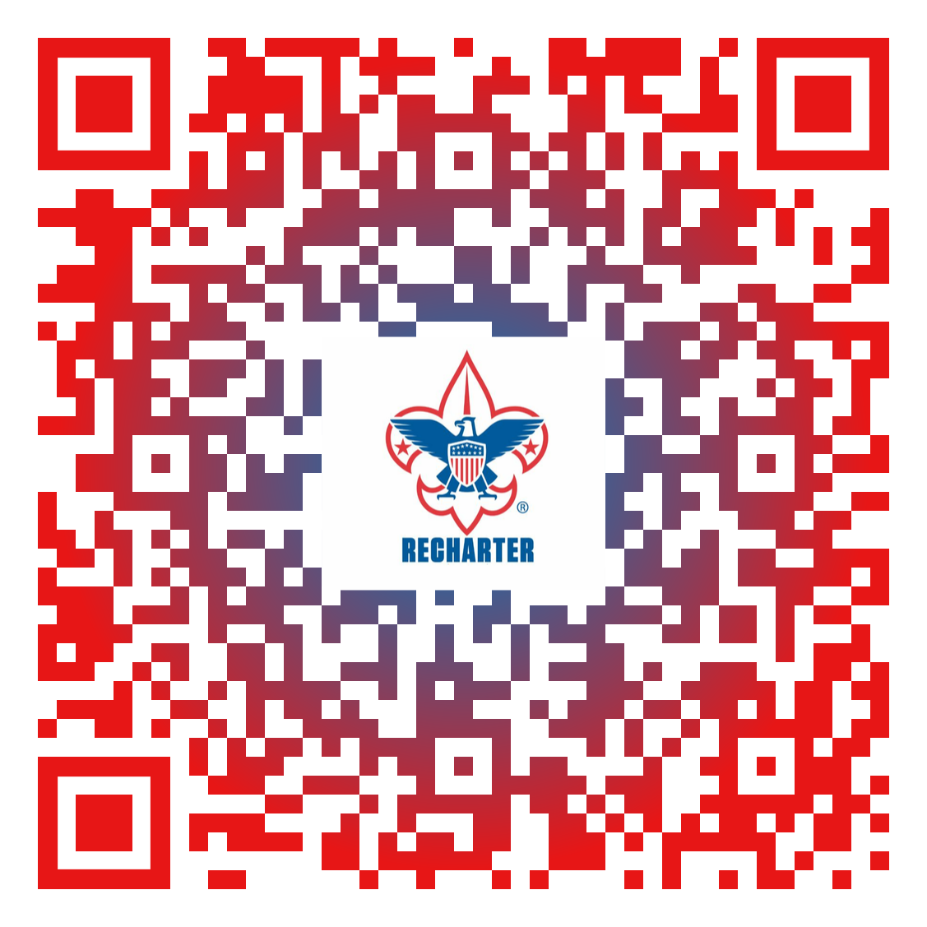
Recharter Resources
Internet Charter Renewal 2.0 - https://www.scouting.org/resources/internet-rechartering/
Review the Internet Recharter Video (revised for 2022)
Download the User Guide (revised for 2022)
View Recent Updates, Changes, and Enhancements
Review the FAQs
Review the Internet Recharter Responses to Forum-Related Questions/Discussions helpdesk
URL: Internet Charter Renewal 2.0 - https://advancements.scouting.org
Your Unit Commissioner, District Commissioner, Council Registrar or Council Recharter Point of Contact
Notes:
These resources are valuable to review prior to recharter system opening as they can answer many of your questions.

Slide 11
Stage 2 – Data Entry
On or after 10/1/22, log into Internet Advancement Website at https://advancements.scouting.org/login and then click on Recharter to load your unit roster and begin updating the roster.
Update / add / remove members from roster
Recheck and verify YPT and Criminal Background Check (CBC). Upload supporting documents.
Update adult leader positions
Designating any members with multiple registrations (members who are members of more than one unit, and pay their dues at the other unit)
Verifying Scouts’ Life subscriptions
All these tasks are explained in the User Guide

Slide 12
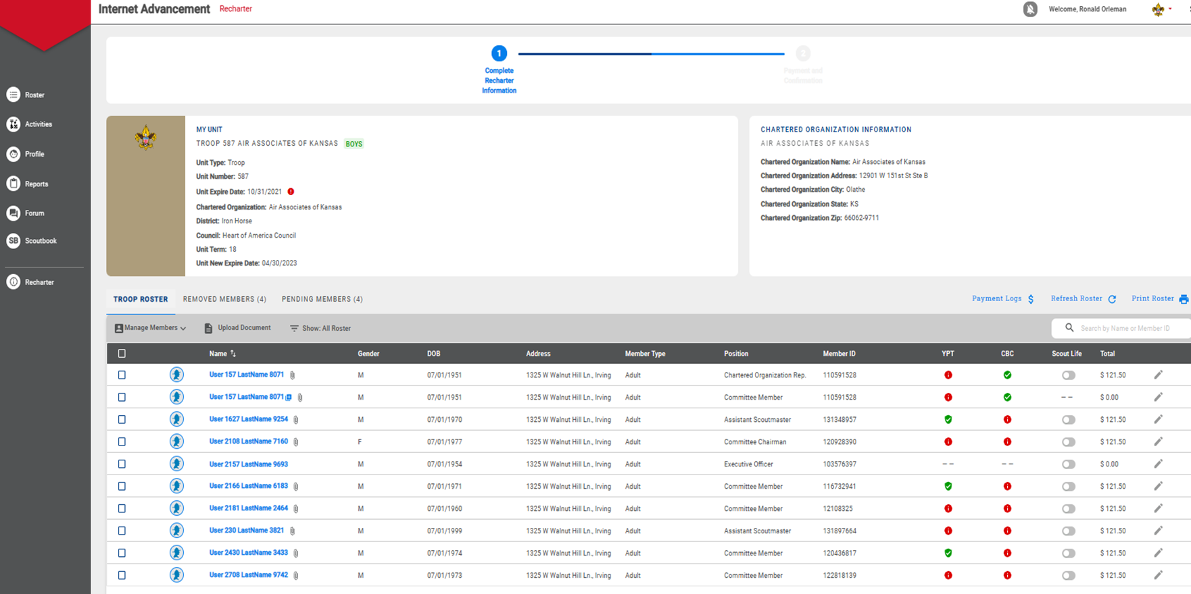
Roster Screenshot

Slide 13
Stage 2 - Validate / Resolve Issues / Pay
After all updates to your roster are complete, select “Validate Recharter and Pay”, at the lower right of the page
The validation results will be displayed in a pop-up. Serious errors must be corrected before submittal. Other issues will require resolution before charter can be posted by Council.
After satisfactory validation, proceed to Payment. You will have a choice of ACH, Credit Card or Pay at Council. See page 26 of the Guide for important ACH information.
You will then submit the recharter. The recharter will be routed to the Unit Key 3 for digital signature.

Slide 14
2022 National Membership Fees
$75 for Cub Scouts, Scouts BSA, Venturing and Sea Scouts participants ($3 increase)
$45 for Exploring participants (no change in cost)
$45 for all adult volunteers (no change in cost, includes cost of background check)
$100 for a unit charter/affiliation fee ($25 increase)
$25 one-time joining fee for new program participants in Cub Scouts, Scouts BSA, Venturing and Sea Scouts (Not pro-rated, no change in cost)
$15 for Scout Life magazine; this is the first price increase since 2005 ($3 increase)
Fee changes effective August 2022

Slide 15
Stage 3 - Resolving Issues (Council)
After electronic submittal of the recharter, any remaining issues must be resolved before your unit’s recharter is posted (finalized).
This includes making your payment in person if you selected this option.
The Council must verify any forms you submitted, and update YPT dates, etc.
The Council will coordinate with the commissioner staff to resolve such issues and complete your recharter.

Slide 16
Notes
Council recommends that UMC units recharter with a traditional charter this year, and transition to the Annual Affiliation Agreement next year. See this link for additional information: https://www.ngumc.org/newsdetail/updates-on-scouting-ministry-and-the-new-affiliation-agreement-16573571
JTE Scorecards and Foothills Honor Roll forms are not Recharter documents. Do not upload them with your Recharter materials. You should coordinate submittal of these forms with your unit commissioner. Blank forms are available on the Foothills website. You may send completed forms to Lewis Hays (contact info on last slide) if your unit commissioner is not available.

Slide 17
Questions
Check the FAQs on the Internet Recharter Resource webpage
Contact your Unit Commissioner
Contact Lewis Hays (LFHays@outlook.com, or 770-617-5399), or any of the other Assistant District Commissioners

